Slide 1

MINI PROJECT 2020-21 (15ECSW301) Multimodal Hateful Meme Detection.
Team : E5.
Guide : Dr P.G. Sunita Hiremath.
TEAM Members:
* Varun Bohara. 01fe18bcs278
* Sakshi Tahlani. 01fe18bcs271
* Abhishek Rao. 01fe18bcs297
* Madhurika Ganiger. 01fe18bcs284

Slide 2
Outline
INTRODUCTION AND MOTIVATION
PROBLEM STATEMENT
OBJECTIVES
LITERATURE SURVEY
PROPOSED METHODOLOGY
REQUIREMENT ANALYSIS
REFERENCES

Slide 3

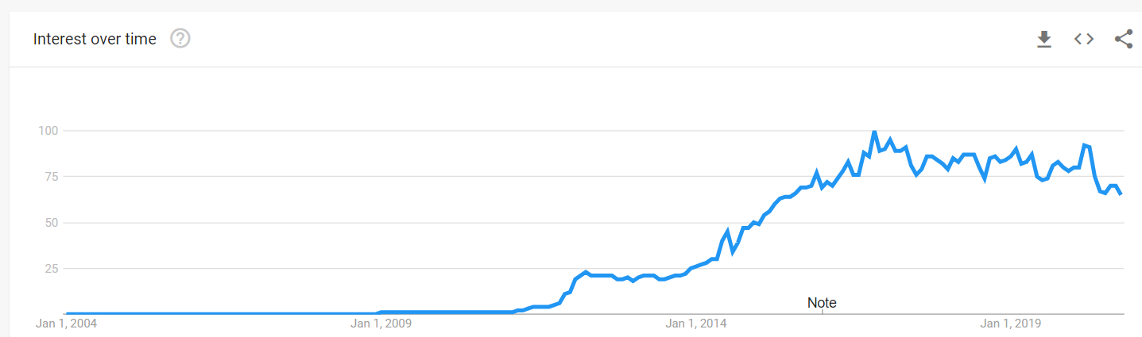
Introduction and Motivation
A meme is an idea, behavior, or style that becomes a trend and spreads by means of imitation from person to person within a culture and often carries symbolic meaning representing a particular phenomenon or theme.
Rise of memes :

Slide 4
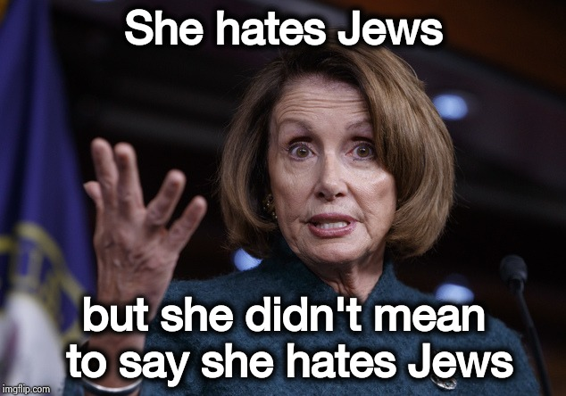
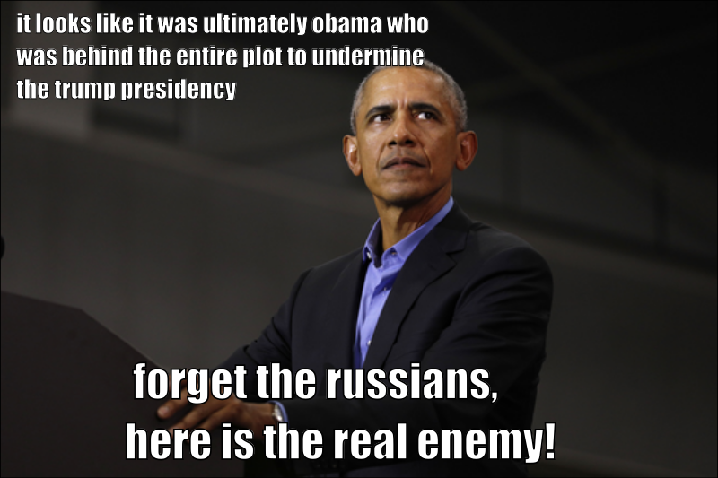
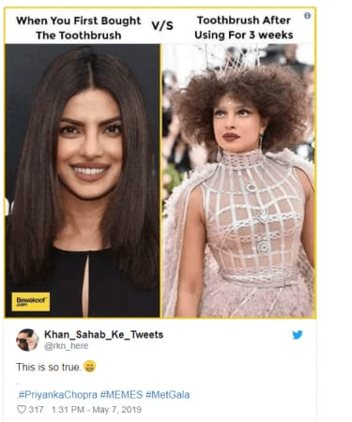

Slide 5
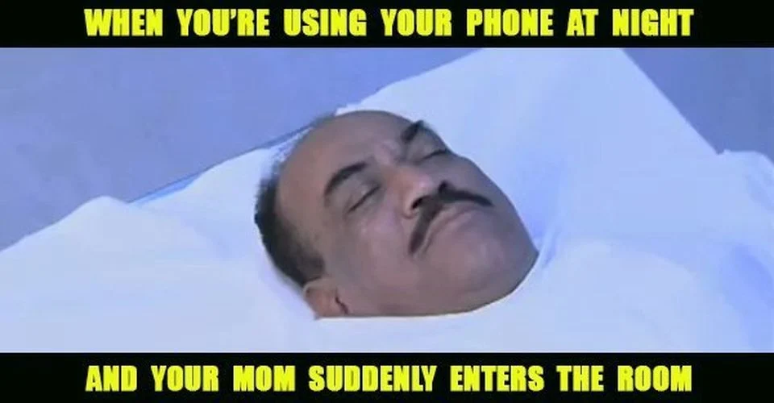
Problem Statement
To develop multimodal architecture which classifies the memes as hateful or non hateful.
Multimodal Architecture
Non Hateful
Output
Input

Slide 6
Objectives
To generate embeddings of image and text .
To fuse the text and image embeddings and build a classifier.
To evaluate the performance of the multimodal architecture.
To compare proposed architecture with state-of-art technique.

Slide 7
Literature Survey

Slide 8
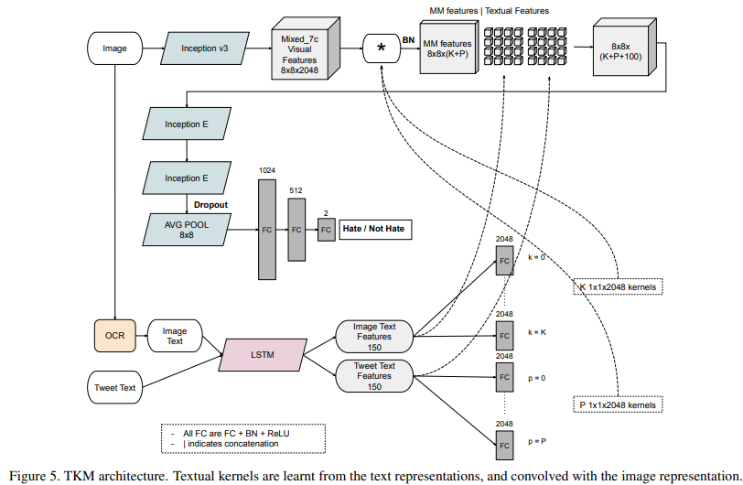
Exploring Hate Speech Detection in Multimodal Publications ( WACV, 2020) [1]
TKM( Textual Kernels Model ):
Inception Model
LSTM Model
Kernel

Slide 9
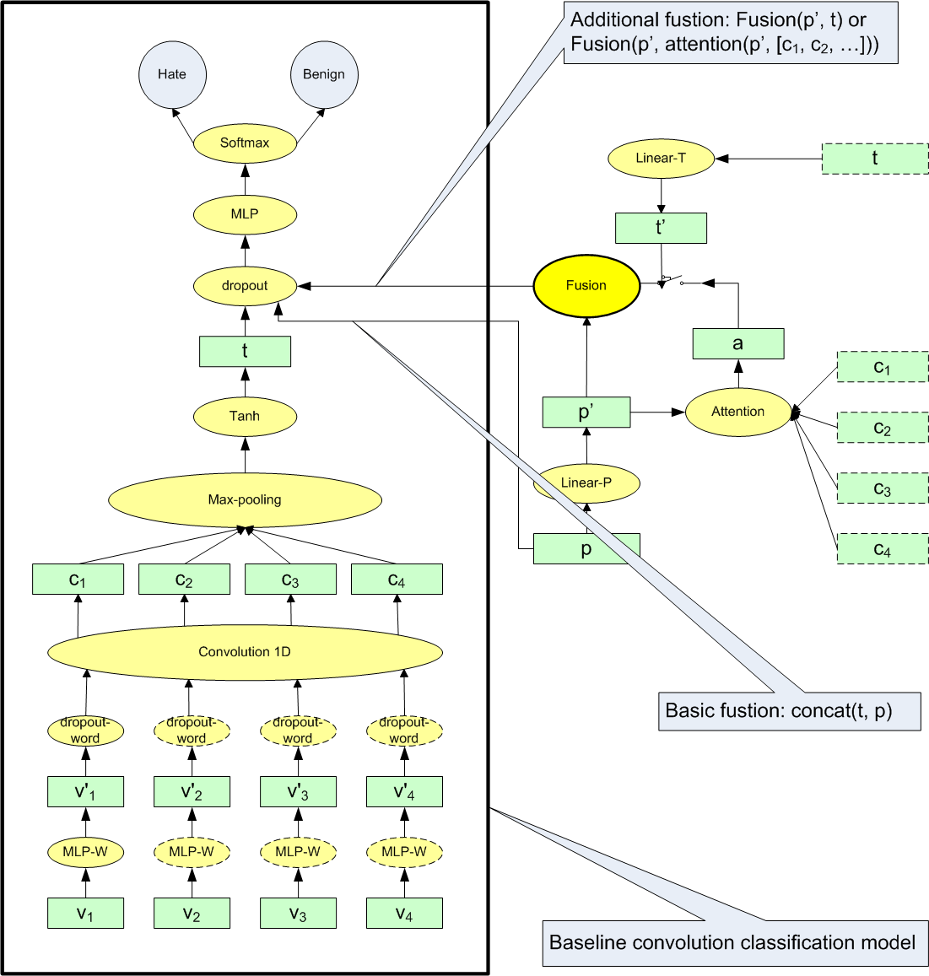
Exploring Deep Multimodal Fusion of Text and Photo for Hate Speech classification[2]
Text: Convolutional classification model
Attention mechanism
Fusion

Slide 10
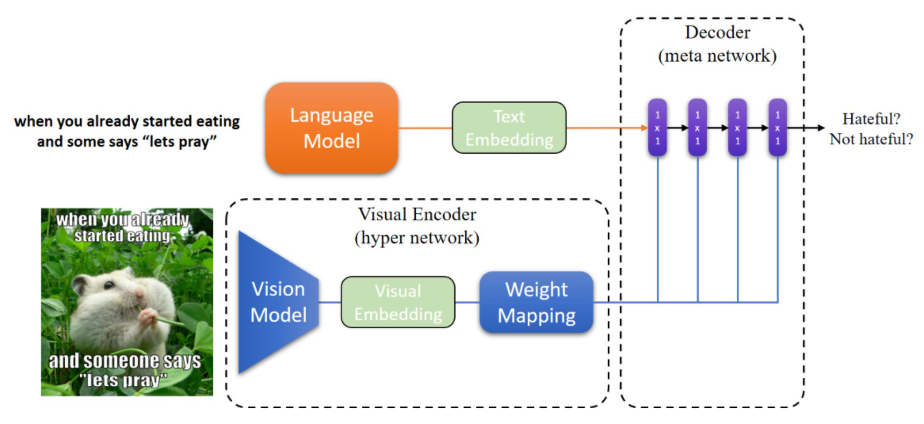
Hateful Memes Challenge 2020, SEP 22 Yuval Nirkin Assaf Rabinowitz Yoni Solel [3]
Data Processing
Text embedding :SBERT
Image Embedding: MobileNetV2
Hypernetworks
Decoder
Varun Bohara

Slide 11
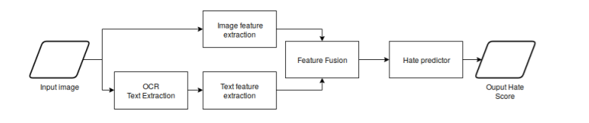
Multimodal Hate Speech Detection in Memes.[4]
Architecture :
Using OCR – Extract the text of the image(pytesseract)
Text Embeddings – BERT (bert-base-multilingual-cased.)
Image Embeddings – VGG-16 (Pre-trained on ImageNet)

Slide 12
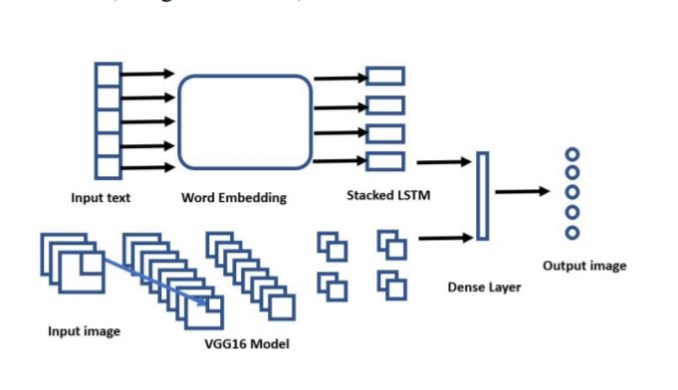
Multimodal Meme Dataset (MultiOFF) for Identifying Offensive Content in Image and Text [5] Shardul Suryawanshi, Bharathi Raja Chakravarthi, Mihael Arcan, Paul Buitelaar
Text Embedding : LSTM
Image Embedding : VGG16
Early Fusion Method

Slide 13
Proposed Methodology
Input
She hates Jews but she didn't
mean to say she hates Jews
Text Module (Sbert)
Decoder
Performance Evaluation
Visual Module (Inception v3)
Output
Hateful/Non-Hateful

Slide 14
Requirement Analysis
Functional
The system shall be able to generate image and text representations .
The system shall be able to classify the meme as hateful or non hateful using provided embeddings .
The system shall be able to generate the probability of the meme being hateful .
The system shall be comparable to the state of the art techniques.
Non Functional
The system should be atleast 70% accurate .
The system should not under-perform on limited computing resources.
In building the system , the framework used should be Keras,on Linux platform.

Slide 15
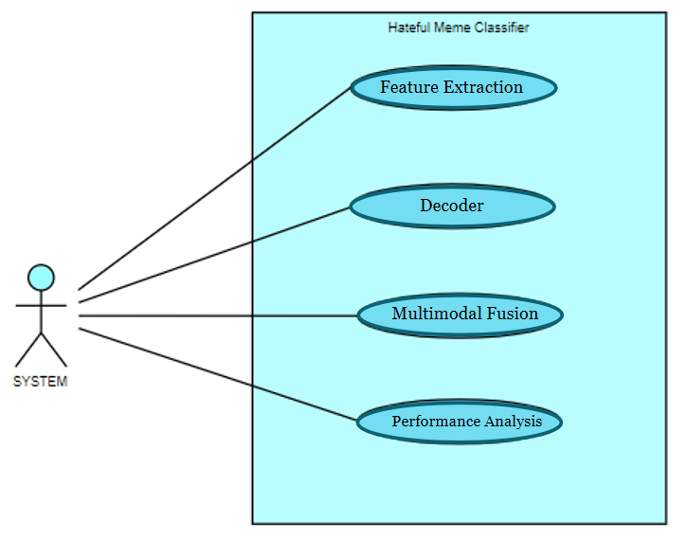
Use Case Diagram

Slide 16
References
[1] Raul Gomez, Jaume Gibert, Lluis Gomez,Dimosthenis Karatzas : Exploring Hate Speech Detection in Multimodal Publications,WACV,2020
[2] Fan Yang ,Xiaochang Peng ,Gargi Ghosh,Facebook Inc,Exploring Deep Multimodal Fusion of Text and Photo for Hate Speech classification,2019
[3] Yuval Nirkin, Assaf Rabinowitz ,Yoni Solel,Hateful Memes Challenge,Sep 22 2020 https://nirkin.com/hateful-memes/
[4] Benet Oriol S`abat: Multimodal Hate Speech Detection in Memes,Universitat Polit`ecnica de Catalunya (UPC),2019
[5] Shardul Suryawanshi, Bharathi Raja Chakravarthi,Mihael Arcan, Paul Buitelaar : Multimodal Meme Dataset (MultiOFF) for Identifying Offensive Content in Image and Text,2020.

Slide 17
THANK YOU

